Slide 1
GRENADA Regional Training Workshop Protecting Caribbean Borders from Illegal Trade in Ozone Depleting Substances (ODS) Organised by: National Ozone Unit (NOU) of Grenada, Energy Division Ministry of Finance, Planning, Energy & Co-operatives Funded by: Multilateral Fund (MLF) for the Implementation of the Montreal Protocol Implementing Agency: United Nations Environment Programme (UNEP)

Slide 2
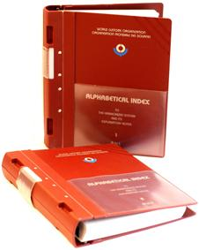
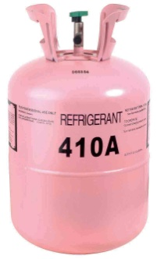
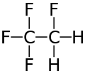
Session 6: ODS Classification
Harmonized System (HS) Tariff Classification
Objectives of a correct HS classification
New HS codes (2012) for ODS and ODS containing mixtures
HS codes for ODS containing equipment
ASHRAE and UN numbers
ASHRAE Designations for single component
Chemical Names
CAS Numbers
Trade Names

Slide 3
HS Tariff Classification
The Harmonized Commodity Description and Coding System (or Harmonized System), is a system for classifying goods in International trade.
How to Read Tariff Numbers The first six digits of the HS number classify the goods Internationally.
Example: Tariff classification 3208.10
32 - First two digits are the chapter
3208 - Third and fourth digits are the header
3208.10 - Fifth and sixth digits are the subheader

Slide 4
HS Tariff Classification
32 08. 10
All countries must
classify the same
substance under
the same Sub-heading
Chapter
Heading
Sub-heading

Slide 5
Objectives of a correct Harmonized System (HS) classification
HS Tariff Classification
Uniform information.
Same tariff treatment for all importers of the same substance.
Information gathering is less complex.
Correct data reporting
pursuant to Art. 7
of the
Montreal Protocol
Licensing
System
Complete
Statistics

Slide 6
HS Tariff Classification
GOVERNMENTS USE HS FOR:
Exchange of trade data.
Establish duties and other taxes.
Control of regulated substances.
Development of Rules of Origin.
Preparation of statistics.
Price and quota controls.
Economic research and analysis.

Slide 7
New HS Classification for ODS
Parties to the Montreal Protocol requested the World Customs Organization (WCO) to revise the HS code for HCFCs.
Based o this WCO Council Recommendation, the relevant amendment of the HS has been agreed upon the HS Contracting Parties and entered into force on 1 January 2012.
As of that date HCFCs and certain other ODS have been separately identified in the HS.

Slide 8
New HS Classification for ODS
HIGHLIGHTS
The five most commonly used HCFCs have been assigned individual HS codes.
The single new code for all CFCs is 2903.77 and it covers all other halongenated derivatives of acyclic hydrocarbons, perhalogenated only with flourine and chlorine.
The HS code for halons 1301, 1211 and 2402 has also been renumbered; from 1 January 2013 the HS code is 2903.76 instead of the previous code of 2903.46
All HS-based Customs Tariffs which follows HS 2012 automatically have the new structure for HS heading 29.03 as of 1 January 2012.

Slide 9
HS Tariff Correlation Table
Name/Group | Chemical name | Formula | ASHRAE # for refrigerants only | HS code since 1 Jan 2012 | HS code until 31 Dec 2011
Annex C, Group I (HCFCs)
HCFC-22 | Chlorodifluoromethane | CHF2Cl | R-22 | --2903.71 | --2903.49
HCFC-123 | Dichlorotrifluoroethanes | C2HF3Cl2 | R-123 | --2903.72 | --2903.49
HCFC-124 | Chlorotetrafluoroethanes | C2HF4Cl | R-124 | --2903.79 | --2903.49
HCFC-141 | Dichlorofluoroethanes | C2H3FCl2 |  | --2903.73 | --2903.49
HCFC-141b | 1,1-dichloro-1-fluoroethane | CH3CFCl2 | R-141b | --2903.73 | --2903.49
HCFC-142 | Chlorodifluoroethanes | C2H3F2Cl |  | --2903.74 | --2903.49
HCFC-142b | 1-chloro-1,1-difluoroethane | CH3CF2Cl | R-142b | --2903.74 | --2903.49
The World Customs Organization’s HS coding system provides uniform codes that are used around the world to facilitate trade. HS Customs codes are the most common way of identifying goods for Customs officers. Thanks to co-operation between the WCO and the UNEP Ozone Secretariat, the 2007 HS update contains new HS codes for ODS-containing mixtures.

Slide 10
HS Tariff Correlation Table
Name/Group | Chemical name | Formula | HS code since 1 Jan 2012 | HS code until 31 Dec 2011
The most popular ODS containing blends
R-500 | CFC-12 / HFC-152a | R-500 | --3824.71 | --3824.71
R-502 | HCFC-22 / CFC-115 | R-502 | --3824.71 | --3824.71
R-401A (MP-39) | HCFC-22/HFC-152a/HCFC-124 | R-401A | --3824.74 | --3824.74
R-408A (FX 10) | HCFC-22/HFC-143a/HFC-125 | R-408A | --3824.74 | --3824.74
R-409A (FX 56) | HCFC-22 / HCFC-124/HCFC-142b | R-409A | --3824.74 | --3824.74
ODS that are traded within mixtures, which is common for solvents and refrigerants, are not easily indicated by the HS codes, because the codes for mixtures are generally based on their function. However, for mixtures used in specific applications such as refrigerants, there is no code related to function. The 2007 HS coding system allows for monitoring trade in certain mixtures containing ODS, such as mixtures containing HCFCs.

Slide 11
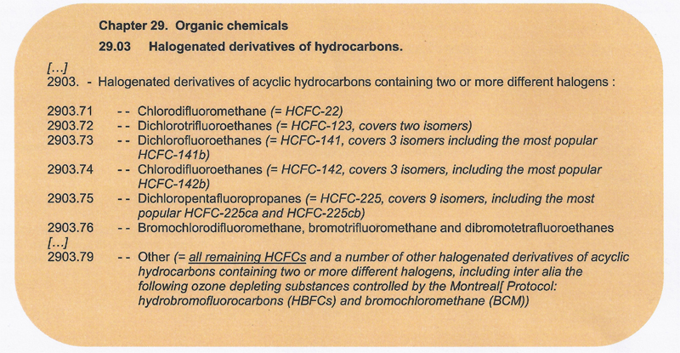
New HS Classification for ODS
Under the new HS 2012, from January 1 2012, HCFCs and certain other ODS will be classified in the HS as follows:

Slide 12
HS codes for ODS-containing mixtures
The HS 2007 classification for blends (i.e. mixtures) containing ODS still applies, and is as follows:

Slide 13
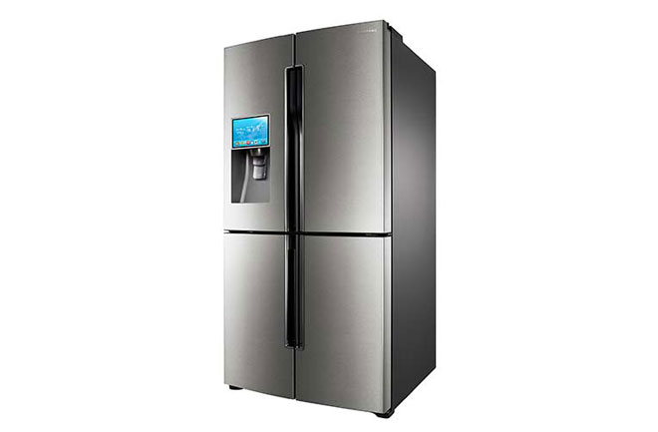
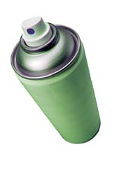
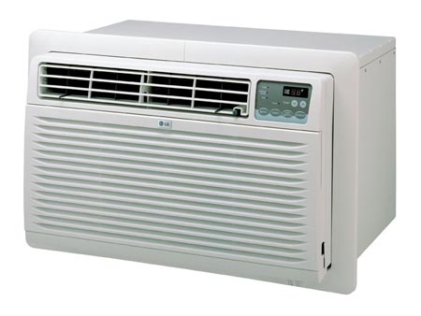
HS Codes for ODS containing equipment
Refrigerators, Freezers, compressors,
fire extinguishers, Dry cleaning equipment: Ch 84.
Vehicles Ch 87.
Cosmetics (Sprays) Ch 33.
Insecticides and solvents Ch 38.

Slide 14
ASHRAE & UN numbers
ASHRAE number
American Society of Heating, Refrigerating, and Air conditioning Engineers
Number designation for refrigerants based on their chemical structure, e.g. R404A
UN Number
United Nations Substance Identification Number (UN SIN or UN number)
A four-digit international standard number which identifies a particular chemical or group of chemicals; e.g. R 404A’s UN number is 3337.

Slide 15
ASHRAE designations for single components
One less than the number of carbon atoms (i.e., there are 1+1 = 2 carbon atoms)
One more than the number of hydrogen atoms (i.e., there are 3-1 = 2 hydrogen atoms)
Number of fluorine atoms (i.e., there are 4 fluorine atoms)
R-134a
The “a” indicates an isomer (i.e., a different arrangement of the same atoms) of R-134
*R-134a is an ODS alternative

Slide 16
Chemical Names
Chemical names serve as an indication of the molecular structure of a substance and the type, number and position of the atoms contained.
Different names and formulas can be used
Chemical names, e.g: Chlorodifluoroethane or HCFC-142 or R-142
Long chemical formula, e.g. C₂H₃F₂Cl
Short chemical formula, e.g. R-142

Slide 17
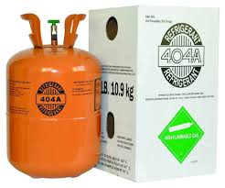
CAS Number
CAS Number
Chemical Abstract Service number to identify a chemical. The CAS Number contains from 5 to 9 digits separated into three groups by hyphens. The first group, starting from the left, has up to 6 digits; the second group always has 2 digits; the third group always has 1 digit.
The CAS Number is specific for single chemicals and for some mixtures.
e.g. R 404A is 75-02-3

Slide 18
Trade Names
The names companies give to their products. The ASHRAE number of a certain chemical, such as 11 or 12, often appears in the trade name.
Algofone 22
Arcton 408 A
Diaflon 502
Forane 409 A
Genatron MP39
Penngas 2
Taisoton 22

Slide 19
Session 7: Support Networks
& Mechanisms for Customs Officers
Cooperation with NOUs and other agencies
Laboratories/destruction facilities
Regional
International (e.g. WCO)
Other (e.g. Industry)
Tools and Materials available
GCI Online Training
Knowledge Check

Slide 20
Session 8:
Illegal Trade Prevention Networks
In the Caribbean
ITPN Overview
Development of a Framework for the operation of an ITPN
RILO Network
iPIC - Informal Prior Informed Consent Network
Customs Ozone Foval Points
MOU for Agency Data Exchange
RCS System
e-SeaClear System
Discussion
Conclusions

Slide 21
ITPN Overview
Illegal trade in Ozone Depleting Substances (ODSs) is an international problem.
It threatens human health and the environment and directly results in the loss of revenue for governments.
An Illegal Trade Prevention Network (ITPN) to improve the coordination of border monitoring and information sharing among enforcement agencies and National Ozone Offices has long been identified as the most effective way to address the control and monitoring of trans-boundary movement of ODS within the Caribbean region.

Slide 22
ITPN Overview
Illegal trade in ODS is a major compliance management risk for the Parties to the Montreal Protocol.
Regulations governing the movement of imports, exports and re-exports exist in individual countries; however, a network to effectively share information between countries in order to monitor, control and prevent the illegal trade in ODS, does not.
Frontline Intelligence networks within the region have worked effectively in curbing the illegal trade in narcotics primarily through the timely exchange of information. These resources along with the spirit of international co-operation and shared responsibility have been identified as major components to be employed in the establishment of an ITPN for ODS and other Chemical MEAs.

Slide 23
Development of Framework
for the operation of an ITPN
Monitoring and Control of Trade Routes
Identify and inform members of Trade routes and trafficking trends – Global, Regional for National Monitoring
Tracking of ODS Shipments
Profiling and Risk Management
Newsletters, Intel. Bulletins, Alerts
Fraud Detection Support
Detection and documentation of mis-description, Diversions, False Documentation

Slide 24
Development of Framework
for the operation of an ITPN
Intelligence officers in customs divisions are charged with data gathering especially in matters of seizures and other infractions.
These officers share information on illegal trade in ODS with both their regional counterparts and the ozone focal point at Customs who in turn will share information with the National Ozone Unit.
The sharing of information should be based on the informal Prior Informed Consent (iPIC) Procedure for Certain Hazardous Chemicals in International Trade as employed under the Rotterdam Convention and should apply to both imports and exports. (licensing system)

Slide 25
ITPN COMPONENTS AND
MODUS OPERANDI
In order to establish a viable network the following components should examined
Regional Intelligence Liaison Office (RILO)
Customs Ozone Focal Point
Memorandum of Understanding (MOU) for Agency Data Exchange to include iPIC procedure
RCS System / E-SeaClear System

Slide 26
Regional Intelligence
Liaison Offices (RILO)
As information and intelligence exchange is one of the pillars of the WCO enforcement strategy, the organization has set up a global network of Regional Intelligence Liaison Offices (RILO).
The RILO network currently comprises eleven (11) offices covering the WCO’s six regions.
Each RILO is a regional centre for collecting and analyzing data as well as disseminating information on trends, modus operandi, routes and significant cases of fraud.

Slide 27
Caribbean RILO strategic priorities for 2008 – 2018 have been outlined as follows:
Capacity Building
Promotion of National/Regional/International Inter-Agency Cooperation
Environmental Agency-Customs
CCLEC-Interpol (MOU)
CCLEC-ACCP (Association of Caribbean Commissioners of Police) (MOU)
Customs-Police (MOU)
Customs-Trading Public
RILO-UNEP

Slide 28
Customs Ozone Focal Points
The Customs ozone focal point should be assigned through a Memorandum of Understanding (MOU) to assist in data gathering in a prescribed format for onward transmission to the National Ozone Unit (NOU).
At each customs division within the region the Intelligence Officer (RILO) will pass any information in relation to the trans-boundary movement of ODS (imports/exports) to the Customs ozone focal point for onward transmission to the National Ozone Office.
It is proposed that information be shared regionally via the existing Internet based RCS System. Additional information extracted from customs systems for exchange with other agencies can be sent via e-mail.
Conditions/parameters for regional customs information exchange are to be established within the MOU mentioned above.

Slide 29
Memorandum of Understanding (MOU)
for Agency Data Exchange
A Memorandum of Understanding should be established to govern the terms under which information is shared between agencies.
Operational details and the prescribed format for cross boundary data exchange along with the legal framework should also be included.

Slide 30
informal Prior Informed Consent-iPIC
iPIC objectives
Information sharing for effective implementation of licensing systems
Key elements
Exporting countries check copy of import licenses voluntarily before issuing export licenses
Importing countries inform exporting countries of their registered importers & quantities allocated to them for that year

Slide 31
RCS System
Customs saw the need to standardize and simplify the clearance system to facilitate the movement of vessels among all the islands and as a result the Regional Clearance System (RCS), an internet based system came into being in 2000.
The system was conceived with the objectives of increasing facilitation and compliance.
At that time, the expectation was that a standardized paper form would be adopted throughout the region.
This has not been an easy undertaking as some countries have different legal obligations and challenges.

Slide 32
RCS System
Deployment - 22 Countries Customs Port Operations and Intel. Units
Vessel/crew Tracking
Seizure Intel. Database
Seizure Data reported to WCO- CEN*
CEN COM- Live Ops. Communication Forum
Expandable – Unlimited capability
*Customs Enforcement Network

Slide 33
RCS System
The RCS program currently in use at customs to track the movement of vessels/crew has been indentified as the most standardized option available for the exchange of information on illegal shipments of ODS.
The program module that stores and shares this type of information should be examined to determine the data elements to be gathered by either the Customs ozone focal point or the Intel Officer to ensure relevant data is gathered for data entry and exchange.

Slide 34
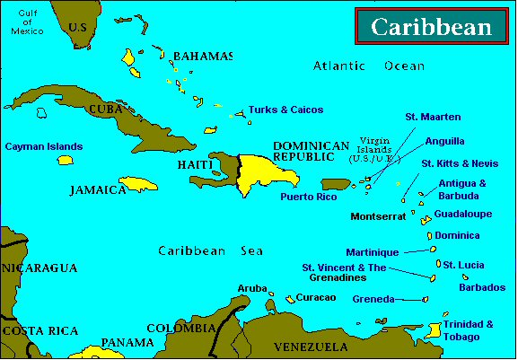
RCS Participating Countries

Slide 35
E-SeaClear System
To achieve the goal of harmonization, a pre arrival notification module was recently developed to facilitate the harmonization of the crew/passenger declaration form.
The e-SeaClear, as it is known, is an online pre-arrival notification system which is available for use by yachts and other pleasure craft operators.
The system allows Captains to submit their Customs declarations in the form of electronic notifications prior to arrival in certain participating countries in the Caribbean.
Registered users can access the system to enter and update declarations about their yachts, crew and passengers while transiting the Caribbean region.

Slide 36
E-SeaClear System
It is an innovative but simple facility which is intended to simplify the clearance process, reduce the time spent with the Customs officials and generally improve the experience of the visiting yacht crew and passengers.
e-SeaClear is now deployed in thirteen countries who have agreed to adopt the electronic Harmonized Clearance Form, including all the OECS countries.
Discussion for broader acceptance of the form by other border agencies is ongoing.
The Caribbean Marine Association (CMA), the umbrella body for national recreational marine trades associations in the region, supports eSeaClear and promotes its use to yachtsmen.

Slide 37
Illegal Trade Prevention Network
DISCUSSION

Slide 38
Conclusion
A sub-regional meeting be held with all parties to design the information sharing network, agree on operational details and decide on a prescribed format for cross boundary data exchange.
Regular meetings should be held in order to foster group integration.
Develop strategic operational plans.
Share up-to-date information on smuggling techniques.
Examine legal frameworks.
Discuss newly introduced regulations in territories.
Examine statistics.
Share illegal case studies.
Discuss and provide solutions to major challenges.
Ensure the timely exchange of information.

Slide 39
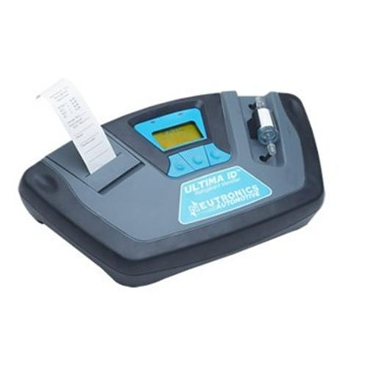
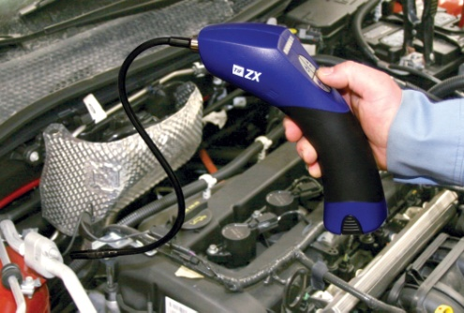
Session 9: Practical Exercises in Identifying Refrigerants
Examples of ODS containers and cylinders and ODS containing equipment and goods
Examining Labels
Colour Codes
Demonstration of ODS identification equipment
Demonstration of leak detectors
Laboratory Analysis

Slide 40
ODS Products
Automobile and truck air-conditioning units (whether incorporated in vehicles or not)
Domestic and commercial refrigeration and air-conditioning/ heat pump equipment, e.g.
Refrigerators
Freezers
Dehumidifiers
Water coolers
Ice machines
Air-conditioning and heat pump units
Aerosol products, except medical aerosols
Portable fire extinguisher
Notes:
See page 84 in UNEP manual for list

Slide 41
Examining Labels
Voluntary labeling of ODS-free products
Some countries have introduced voluntary labeling schemes for ozone-friendly technology at the national level (so-called positive labeling). Companies that wish to use such ozone-friendly labels on their products must comply with certain criteria. Currently, no labeling requirement exists for ODS-based technology.
Equipment Labeling
Equipment labeling usually indicates the manufacturer, the power supply, some basic technical data and the type and quantities of the working fluids.
There are also no standards specifying the locations for labeling. Customs officers may therefore have difficulty finding them.

Slide 42
Examining Labels
Refrigerator labels
Refrigerator labels are found in various locations. The cardboard box containing the refrigerator may have a label that specifies the refrigerant. The user instructions may also provide this information. Labels are often on the side, the back or sometimes hidden on the ceiling of the cooling compartment, or on the backside of the refrigerator.
Quite often, such labels are falsified and do not provide information on the actual refrigerant contained in the compressor. Therefore, the compressor should always be inspected, which may require removing the back cover. The compressor should have a metal label fixed to it, and the ASHRAE name of the refrigerant (such as R-22) should be engraved there.
Important: The compressor should never be inspected while the refrigerator is plugged in.

Slide 43
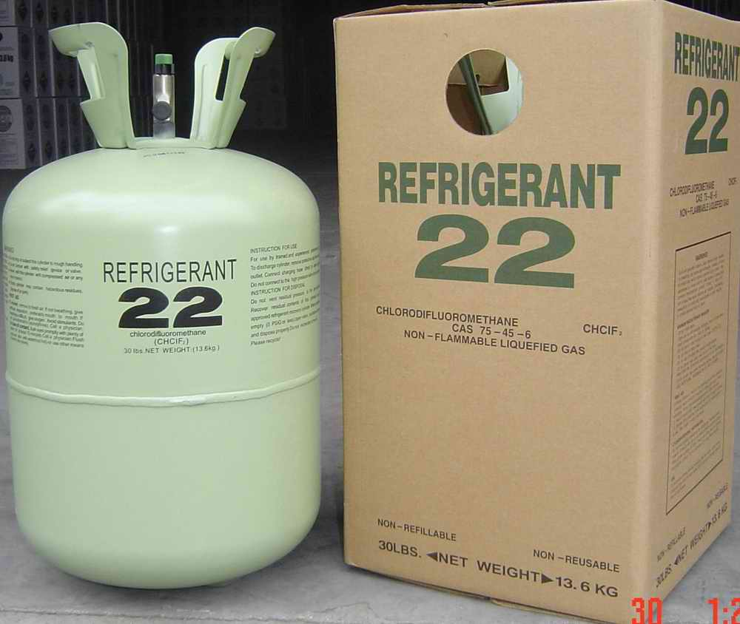
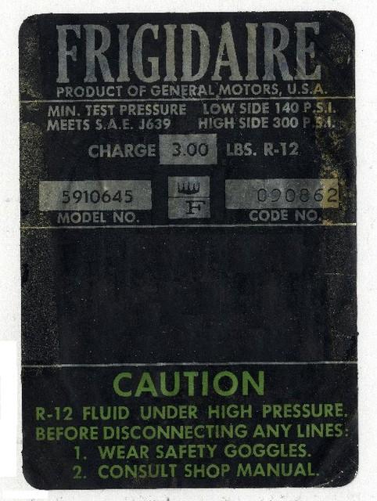
Examples of Labels
Examining Labels
Cooling Equipment
Cylinders
Vehicles
Compressors
Notes:
See Pages 76 – 78 of UNEP Manual

Slide 44
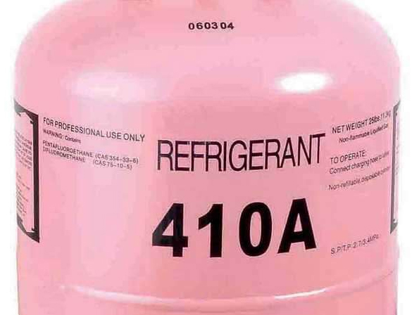
Examples of Labels
Examining Labels

Slide 45
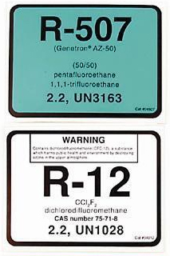
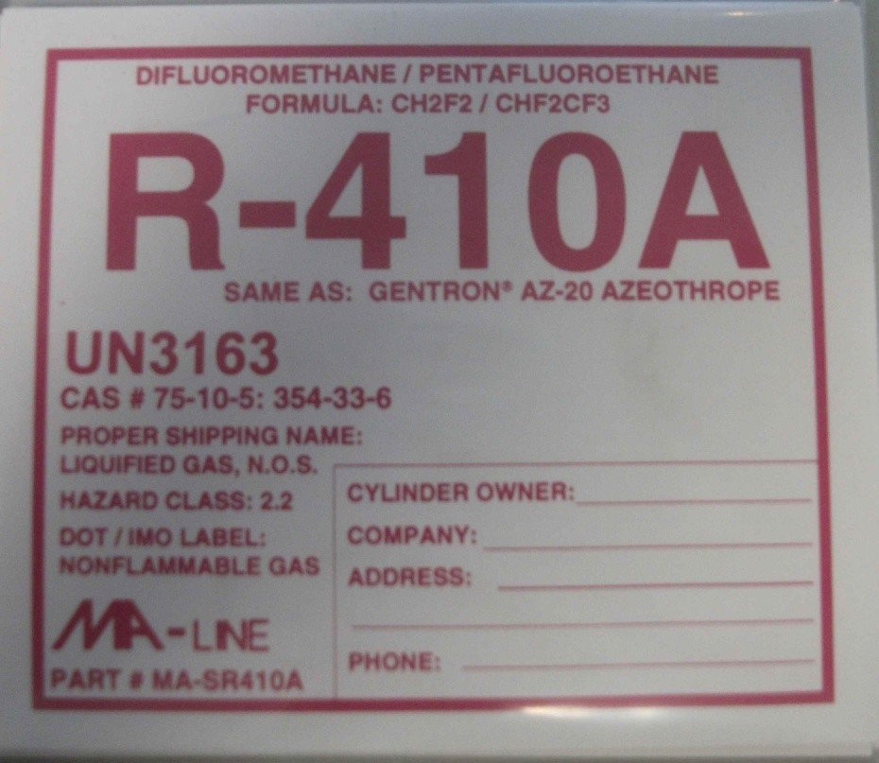
Examples of Labels
Examining Labels
Notes:
See Pages 76 – 78 of UNEP Manual

Slide 46
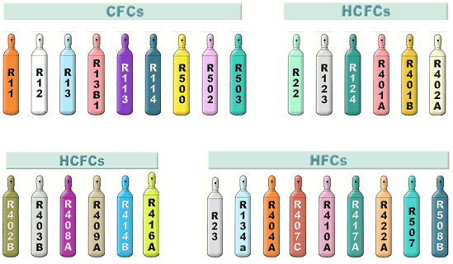
Colour Codes

Slide 47
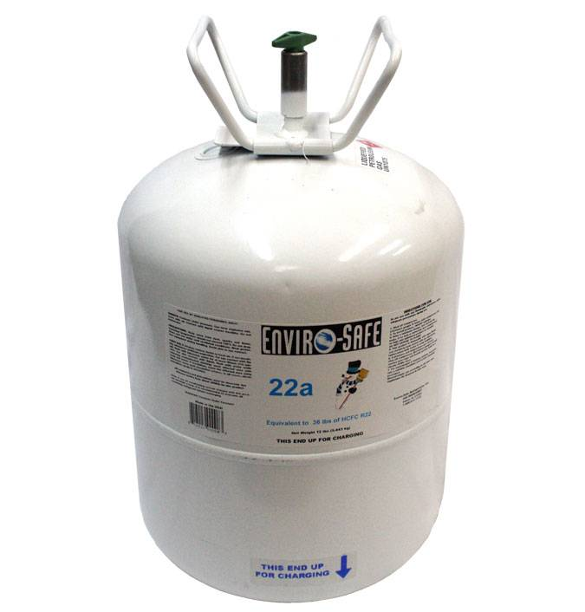
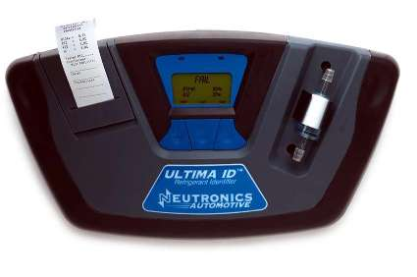
ULTIMA ID™
REFRIGERANT IDENTIFIER

Slide 48
Refrigerant identifiers are small portable units used to identify certain ODS and non-ODS.
The main function of refrigerant identifiers is to assist servicing technicians in checking the purity of commonly used refrigerants in refrigeration and air-conditioning equipment.
Identifiers are increasingly being used by Customs officers at frontline positions to examine ODS shipments that might have been falsely declared to be non-ODS chemicals.
Grenada Customs performs a 100% check of all imported refrigerants.

Slide 49
The Neutronics Ultima ID Refrigerant Identifier provides a fast, easy and accurate means to determine refrigerant purity in refrigerant storage cylinders or directly in vehicle air conditioning systems.
The instrument is supplied complete with a R12 and R134a sample hose, a R134a adapter fitting to permit sampling of ACME ported cylinders, a 12 VDC power cord and all required plumbing housed within a rugged, portable, storage case.

Slide 50
Sample gas is admitted into the instrument through the supplied hose and presented to the sensing device. The instrument provides the user with direct percent by weight concentrations of R12, R134a, R22 and hydrocarbons.
If the sample is determined to be pure R134a, the instrument will provide a direct readout of the weight percentage of air within the sample. Note that the instrument does not consider air to be a contaminate since it can be removed by most refrigerant recycling equipment.
Since air is not considered a contaminate, it is possible to read 100% R134a plus 5% air.

Slide 51
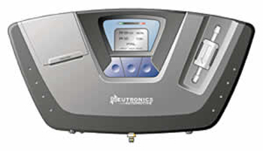
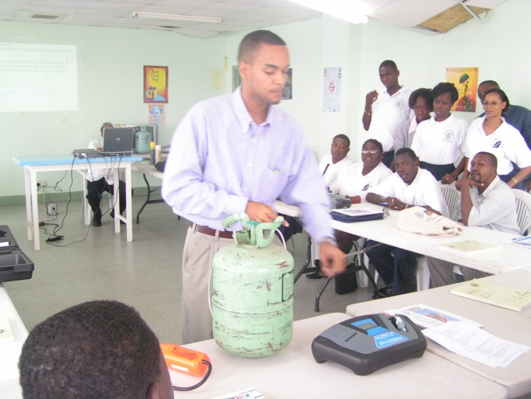
ULTIMA ID™
REFRIGERANT IDENTIFIER
PRACTICAL EXERCISES

Slide 52
Turning On The Unit
Connect the supplied vehicle power cable to the 12VDC power input jack on the back of the unit. Connect the battery clips to the vehicles 12VDC battery. (Note: If the optional battery module is installed and charged, the vehicle power cable is not required.) Press the left, soft key, power button and the splash screen shown in Figure 1 will appear for approximately three seconds followed by the elevation screen shown in Figure 2.
Depressing the "DONE" button will bring the Ultima ID to the Calibration screen as shown in Figure 3.
ULTIMA ID
SOFTWARE VERSION
XXX XX.XXX
THE OPERATING
ELEVATION HAS
NOT BEEN SET
SELECT HELP ON
THE NEXT SCREEN
DONE
READY FOR AIR CAL
DISCONNECT HOSE ROM VEHICLE
PRESS CA L TO START
OFF HELP CAL
Figure 1
Figure 2
Figure 3

Slide 53
Calibration
Each time the Ultima ID begins a new test cycle it must first self calibrate. The calibration takes 30 seconds (Figure 4) and brings fresh air into the unit via an internal pump. This fresh air purges any excess refrigerant from the unit and ensures accurate test results. Calibration requires that the hose be disconnected from the vehicle or refrigerant cylinder. During calibration, the screen shown in Figure 5 will appear reminding the user to change the filter under certain conditions. The calibration of the unit will expire after approximately five minutes of inactivity. If this occurs, the screen shown in Figure 6 will be displayed requiring the calibration to be initiated again.
CALIBRATING
THIS WILL ONLY
TAKE 30 SECONDS
- CALIBRATING -
NOTE
REPLACE FILTER WHEN WHITE ELEMENT BEGINS TO SHOW RED
SPOTS ON THE OUTSIDE DIAMETER
CALIBRATION TIME HAS EXPIRED
DISCONNECT HOSE FROM VEHICLE AND PRESS CAL TO RECALIBRATE
CAL
Figure 4
Figure 5
Figure 6

Slide 54
Calibration (cont’d)
After calibrating, the unit will display the screen shown in Figure 7.
Connect the hose to the vehicle, (for R134a open the valve) and select the refrigerant type you wish to test. The Ultima ID will display the screen shown in Figure 8.
READY
CONNECT HOSE OPEN VALVE
SELECT REFRIGERANT TO TEST
R12 HELP R134A
TESTING
RXXX SAMPLE
THIS WILL ONLY
TAKE 30 SECONDS
Figure 7
Figure 8

Slide 55
Viewing the Test Results
Upon completion of the test, the Ultima ID will display a screen similar to that shown in Figure 9 or Figure 10.
PASS
R134 100.0%
AIR 2.8%
HELP MORE
FAIL
R134 95.0%
HELP MORE
Figure 9
Figure 10

Slide 56
Viewing the Test Results (cont’d)
If the refrigerant tested is 98% pure or better, and the air content is less than 90%, the "PASS“ screen will display and the Green LED will illuminate.
Should the refrigerant be less than 98% pure or the air content greater than 90%, the "FAIL" screen will display and the Red LED will illuminate.
In either case, selecting the "MORE" button will display the details in Figure 11 for "PASS" and Figure 12 for "FAIL".
RESULTS…….PASS
R134 100.0%
R12 .0%
R22 .0%
HC .0%
AIR 2.8%
EXIT PRINT
RESULTS…….FAIL
R134 95.0%
R12 5.0%
R22 .0%
HC .0%
EXIT PRINT
Figure 11
Figure 12

Slide 57
Printing the Test Results
The unit is equipped with the optional built-in printer module, the test results can be printed by selecting the "PRINT" button.
After the print is complete, carefully tear off the printout and the
unit will return to the previous screen.
Additional printouts may be made following the same
procedure. To exit the test, press the "EXIT" button.

Slide 58
Leak Detectors
Leak detectors do not identify or analyse a specific refrigerant. Rather, they indicate the presence of certain atoms in the air (such as chlorine or fluorine atoms) that would be present only if the cylinder is leaking. Therefore, leak detectors cannot be used for identification of ODS; they can only indicate that the leaking cylinder contains some ODS or ODS substitute.
New cylinders filled with virgin refrigerant usually do not leak. Refilled containers may leak and can be mislabelled. For safety reasons, storage areas for refrigerants should be inspected regularly.
The “soap bubble method” is another simple method to locate leaks. This method does not require any testing equipment other than liquid soap.

Slide 59
Laboratory Analysis
Laboratories use more extensive techniques for testing (gas chromatography, infrared analysis) than field equipment.
Laboratory testing can identify specific compounds.
What size containers can be sent directly to the laboratory?
Check with the lab to see who can take samples.
Should be conducted by a professional.

Slide 60
Session 10:
Workshop Evaluation For Brokers
Completion of evaluation questionnaires
General Feedback and comments from brokers and organisers
Presentation of Certificates to Brokers

Slide 61
GRENADA Regional Training Workshop Protecting Caribbean Borders from Illegal Trade in Ozone Depleting Substances (ODS) Organised by: National Ozone Unit (NOU) of Grenada, Energy Division Ministry of Finance, Planning, Energy & Co-operatives Funded by: Multilateral Fund (MLF) for the Implementation of the Montreal Protocol Implementing Agency: United Nations Environment Programme (UNEP)

